Slide 1
SD-389: Automotive and VR/AR use cases
bbf2016.887.00
Andrew G. Malis, Huawei
George Dobrowski, Huawei
Georgios Karagiannis, Huawei
Mauro Tilocca, Telecom Italia
Bruno Cornaglia, Vodafone Italy
Jie Hu, China Telecom
Hai Ding, China Unicom

Slide 2
Use Cases and Relevance to BBF
  initiate work in the BBF BAS context that will focus on providing requirements imposed by these use cases on BBF MSBN network performance and as well as the architecture (functionalities/entities/interfaces) needed for the support of these requirements:
    Delay
    Jitter
    Packet Loss ratio
    Availability
    Security

Slide 3
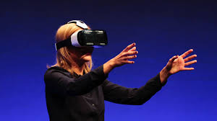
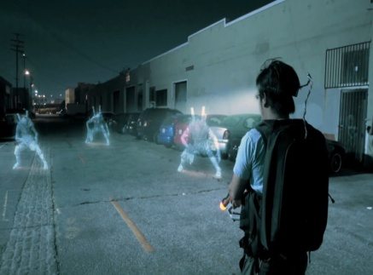
Virtual and Augmented Reality Use Cases
  Virtual Reality (e.g., Google Cardboard) also known as immersive multimedia or computer-simulated reality, is a computer technology that replicates an environment, real or imagined, and simulates a user’s physical presence and environment to allow for user interaction
    Headsets: Head-mounted display (HMD) units use a small screen or a pair of screens that are worn in a helmet or a pair of glasses
    Reality Engine: Reality Engines are based largely on the same components that make up a personal computer (PC), although much more computing power is required for the reality engine than is available in a standard PC
    Audio units: The audio portion of virtual reality is transmitted through small speakers placed over each ear
    Gloves: VR gloves allow the users to interact with the virtual world
Bottlnecks/Requirements:
  latency: Should not exceed 20 ms
  high cost, especially for higher-end sysstems
  stringent requirements for the underlying network, including high bandwidth (4 to 8 times HD or 4K) times, low latency, and low packet loss rate

Slide 4
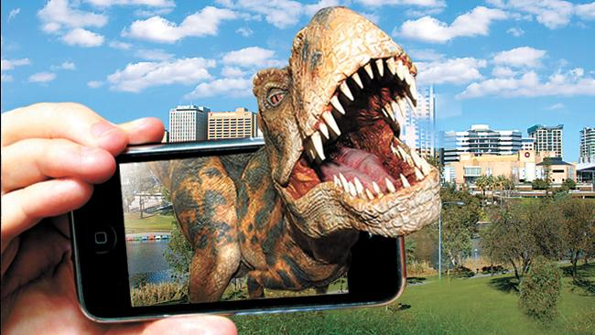
Virtual and Augmented Reality Use Cases
  Augmented Reality (e.g., Pokémon Go), users continue to be in touch with the real world while interacting with virtual objects around them
    With VR, the user is isolated from the real world while immersed in a world that is completely fabricated
Bottlnecks/Requirements:
  latency: Should not exceed 3 ms
  high cost, especially for higher-end sysstems
  stringent requirements for the underlying network, on latency and low packet loss rate (lower bandwidth requirements than VR, since much of the image is locally sourced)

Slide 5
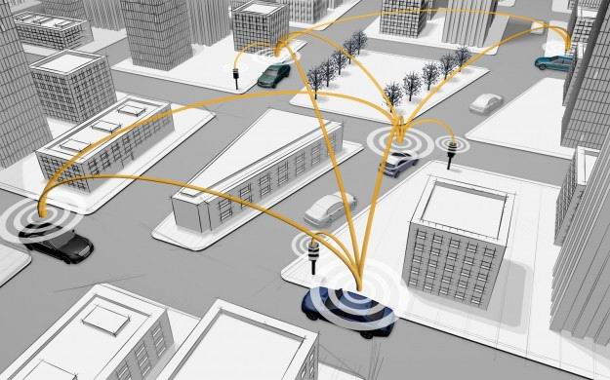
Automotive Low Latency Use Cases
  IoV (Internet of Vehicles - IoV) is a converged technology that encompasses information communication, environment protection, energy conservation and safety
    refers to dynamic mobile communication systems that communicate between vehicles and public networks using V2V (vehicle-to-vehicle), V2R (vehicle-to-road), V2H (vehicle-to-human) and V2S (vehicle-to-sensor) interactions
    enables information sharing and gathering of information on vehicles, road, and their surroundings used by system to effectively guide and supervise vehicles, and provide abundant multimedia and mobile Internet application services.
Bottlnecks/Requirements:
  latency: should be less than 10ms. In some other analysis reports, it is even further compressed to 5ms
  high availability: reliable data transfer with a drop rate less than 0.001%
  Support high-speed vehicle movement: up to 500 km/h
  Security (and privacy): high protection against malicious attacks (critical systems)

Slide 6
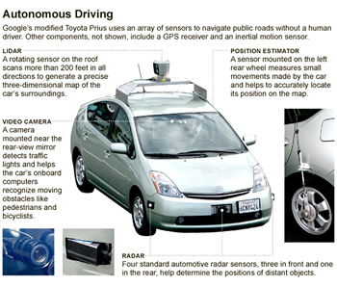
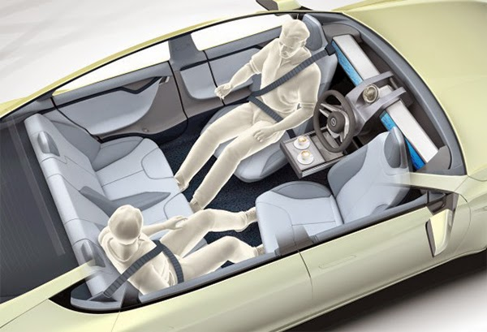
Automotive Low Latency Use Cases
  An autonomous vehicle (driverless car, self-driving car, robotic car) is a vehicle that is capable of sensing its environment and navigating without human input
    automated vehicles would have no driver error, so fewer crashes will be result.
    traffic flow could be more efficient and congestion decreased
    vehicles occupants could spend travel time engaged in activities other than driving
    space used for parking could be repurposed because automated vehicles won’t need proximate urban parking
Bottlnecks/Requirements:
  latency: rigorous latency requirement for the mobile network, which should not exceed 5ms, with low variability
  high availability: should be assured
  Support high-speed vehicle movement: up to 500 km/h
  Security (and privacy): high protection against malicious attacks (critical systems)
  location accuracy for the autonomous vehicle: f the location is incorrect, the travel route may not be correct, and some accidents may even occur

Slide 7
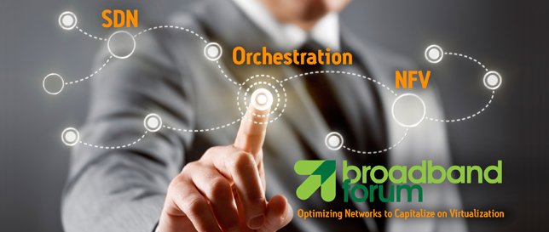
Q&A
www.broadband-forum.org

